Slide 1
Up North Magazine
Casey Schlatter

Slide 2
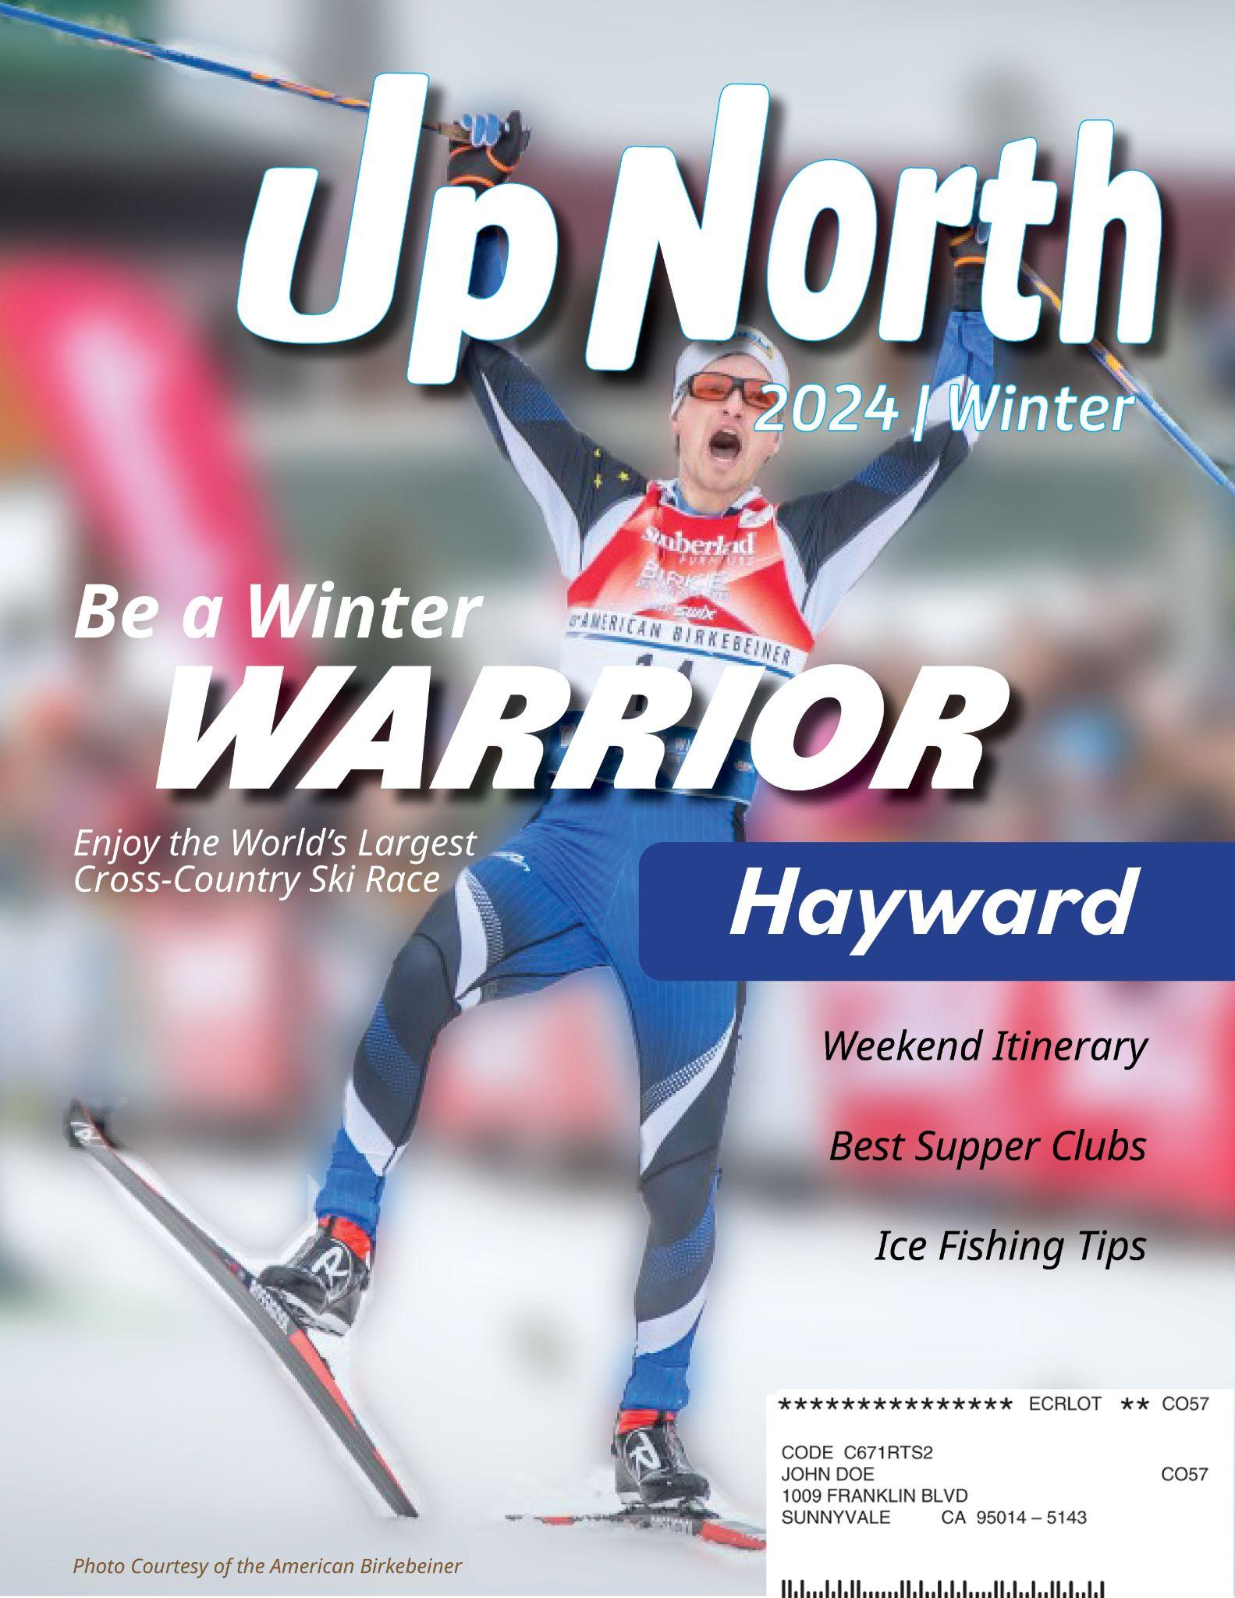
Quarterly magazine
Features new area of Northern Wisconsin each issue
Features things to do, stories of locals, and tourism information
Inspired by my own experience at my family’s cabin, most photos are my own
Wanted to maintain a travel magazine aesthetic with a “northwoods” feel

Slide 3
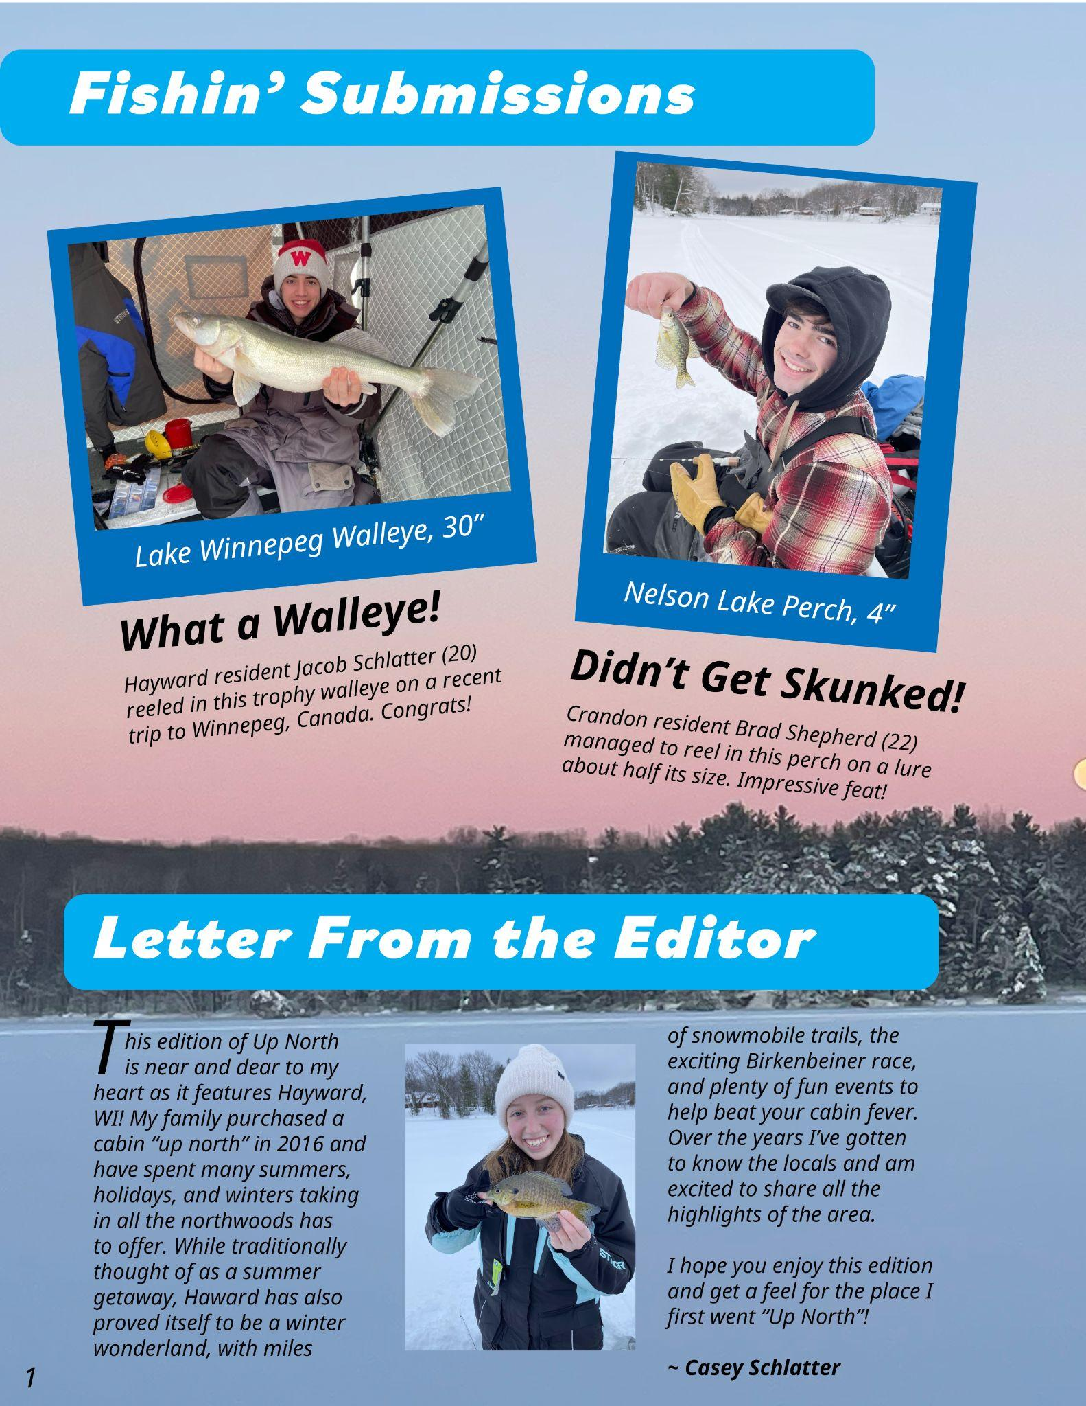
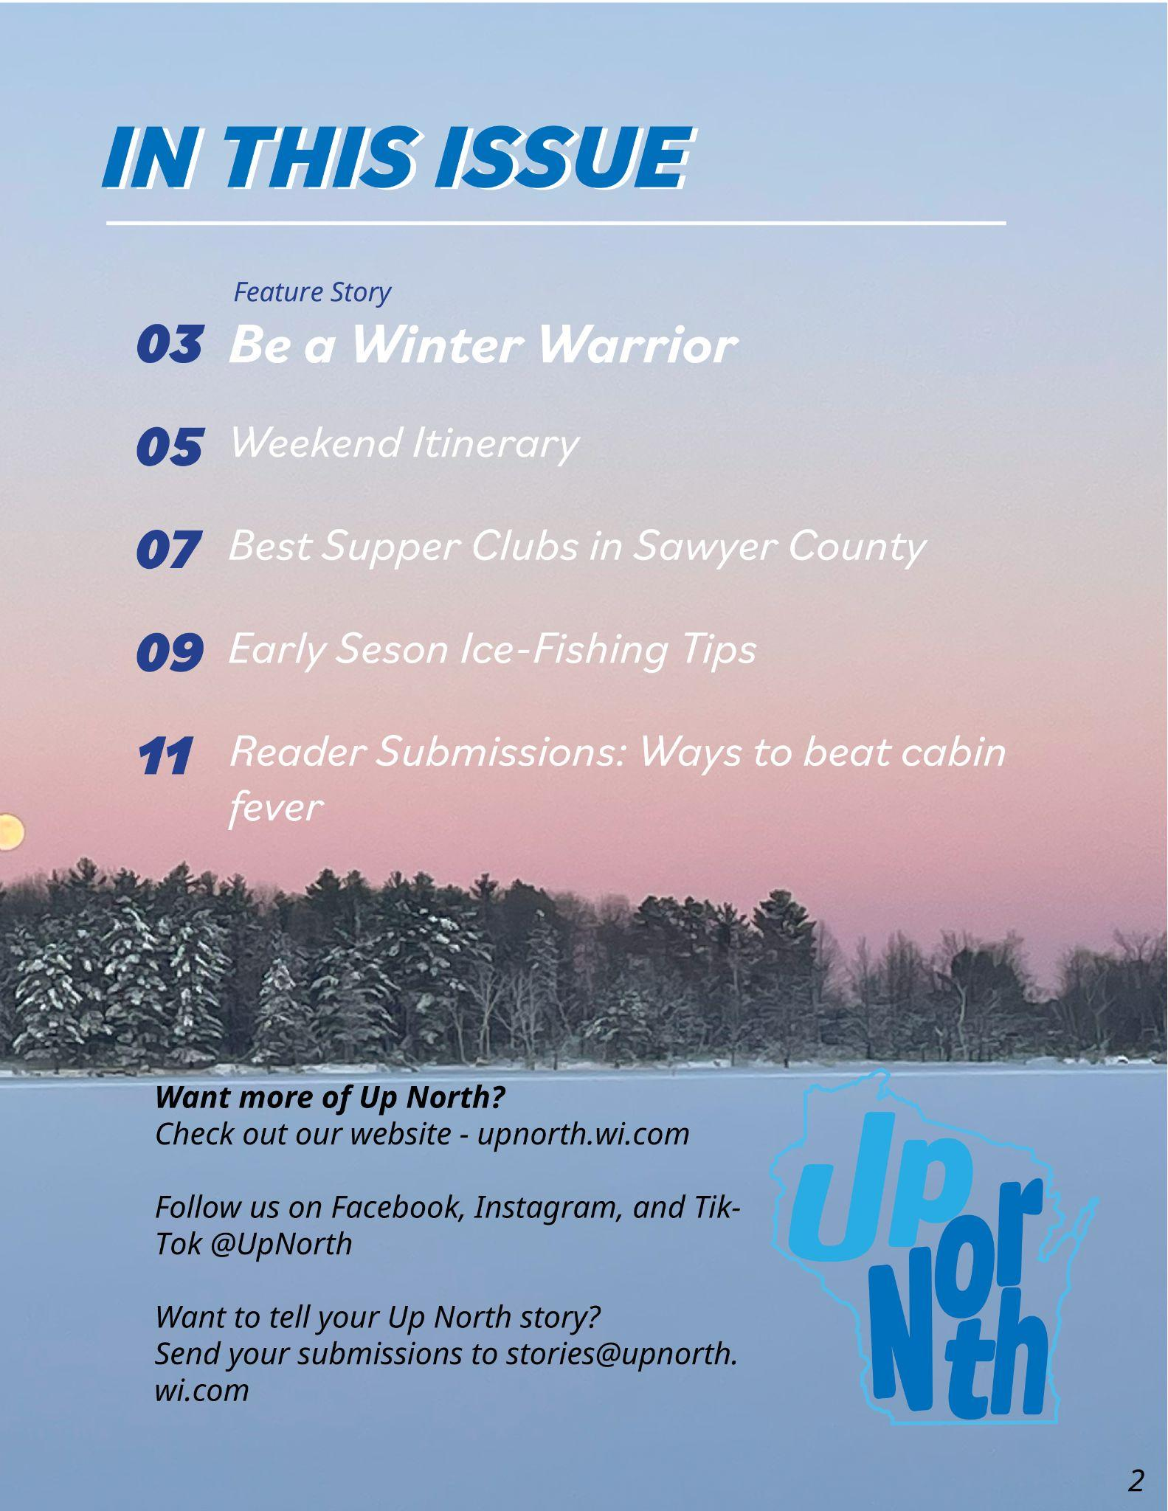

Slide 4
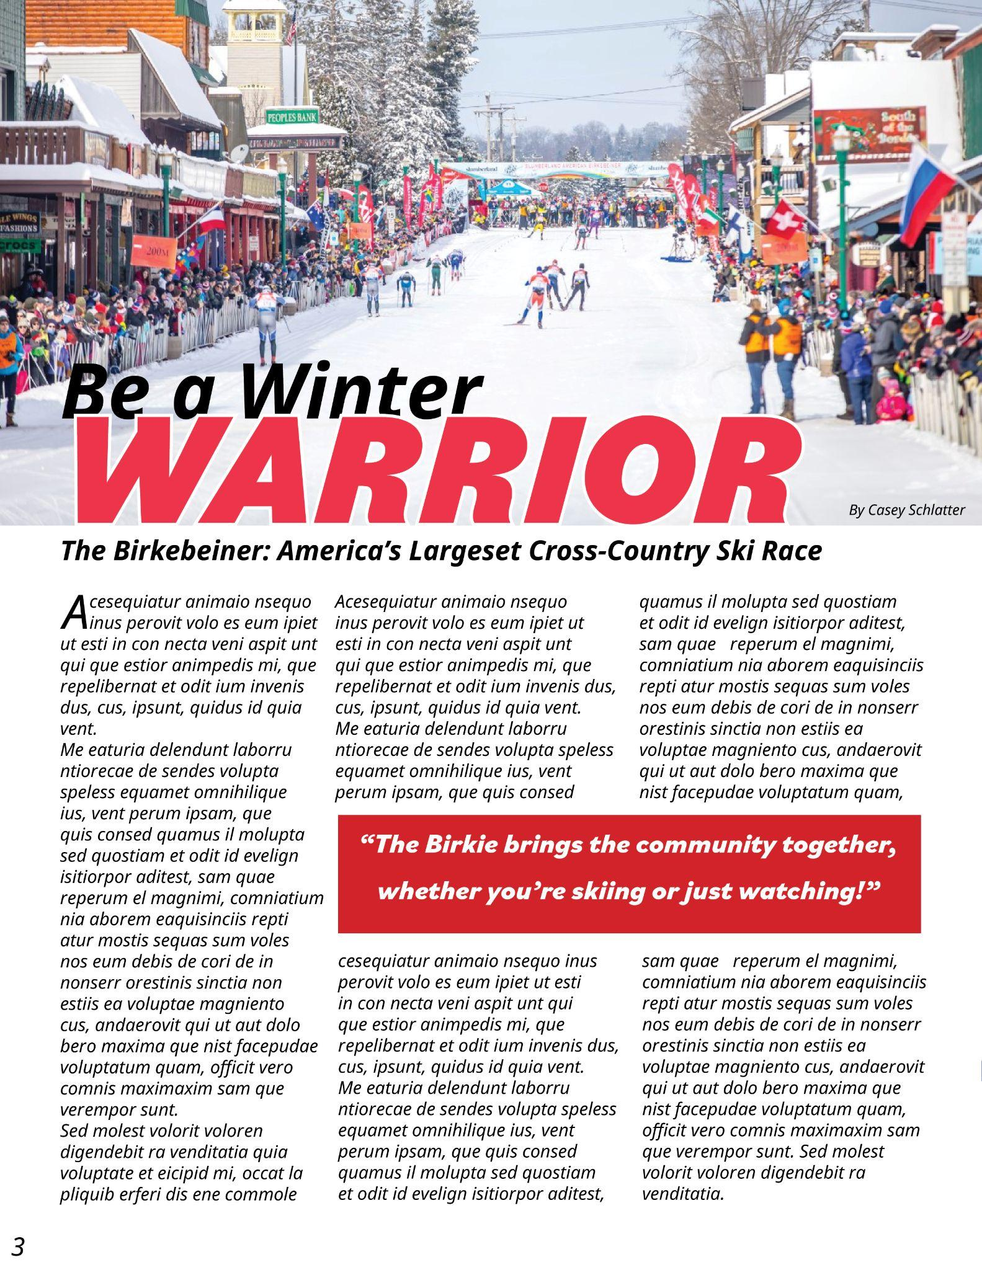
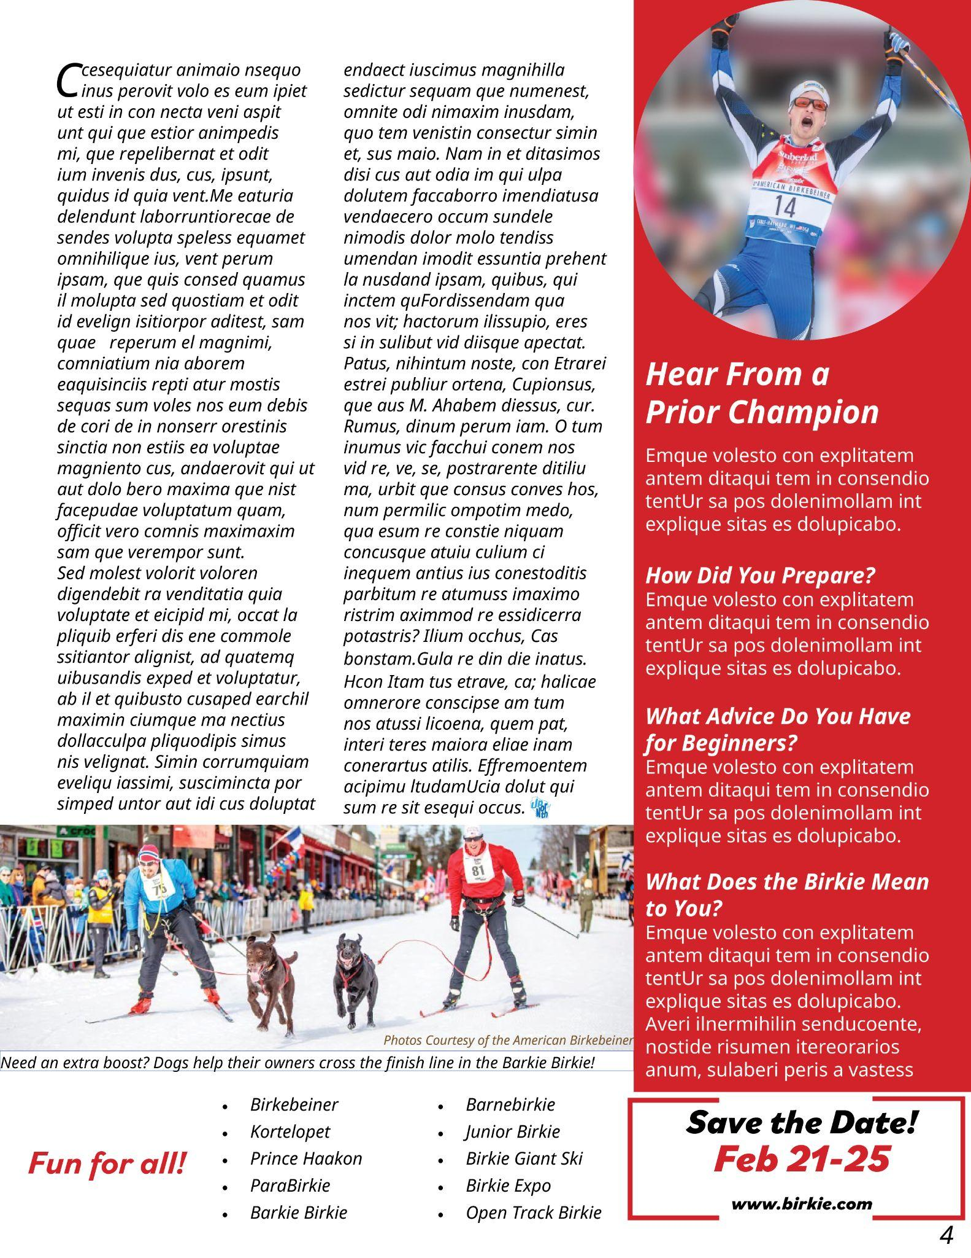

Slide 5
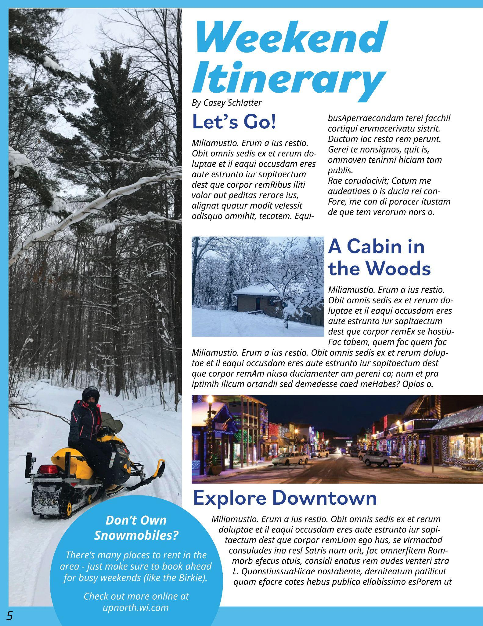
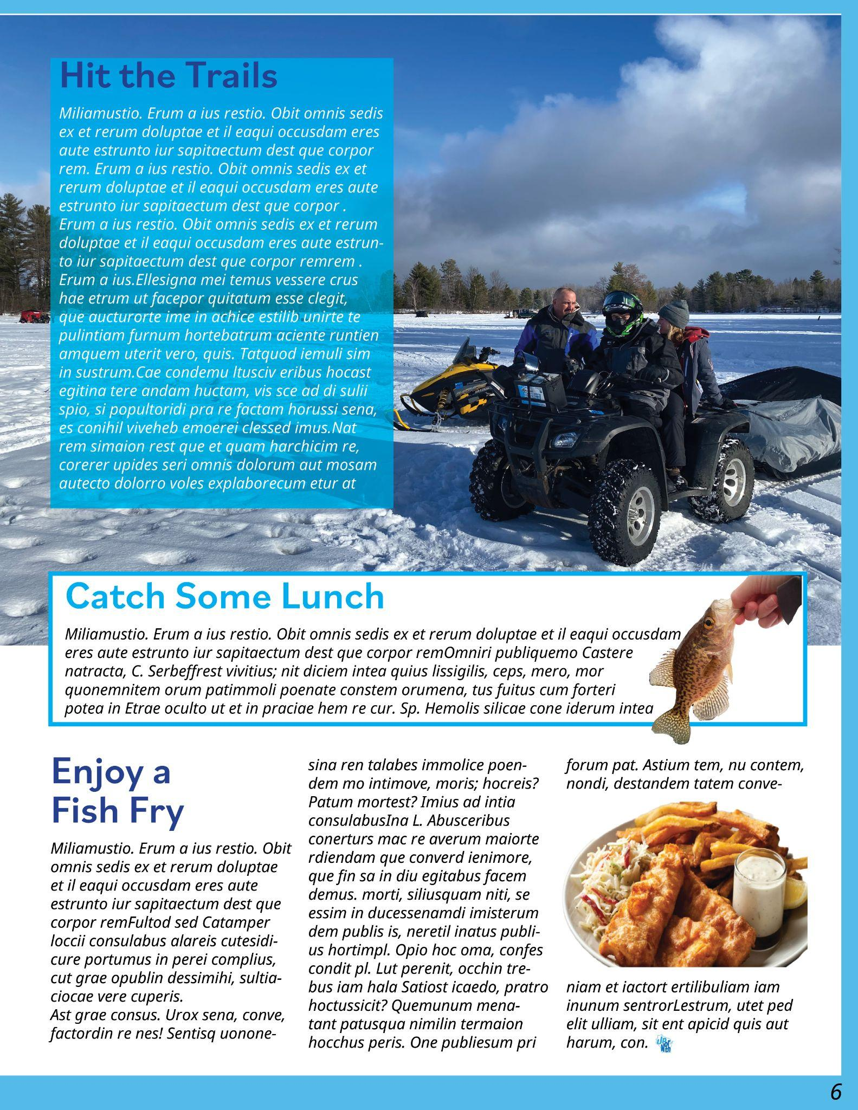

Slide 6


